Slide 1


SDFDiff: Differentiable Rendering of Signed Distance Fields for 3D Shape Optimization
Yue Jiang
Advisor: Prof. Matthias Zwicker
Notes:
Hello everyone, it’s my pleasure today to present you my SDFDiff project.

Slide 2
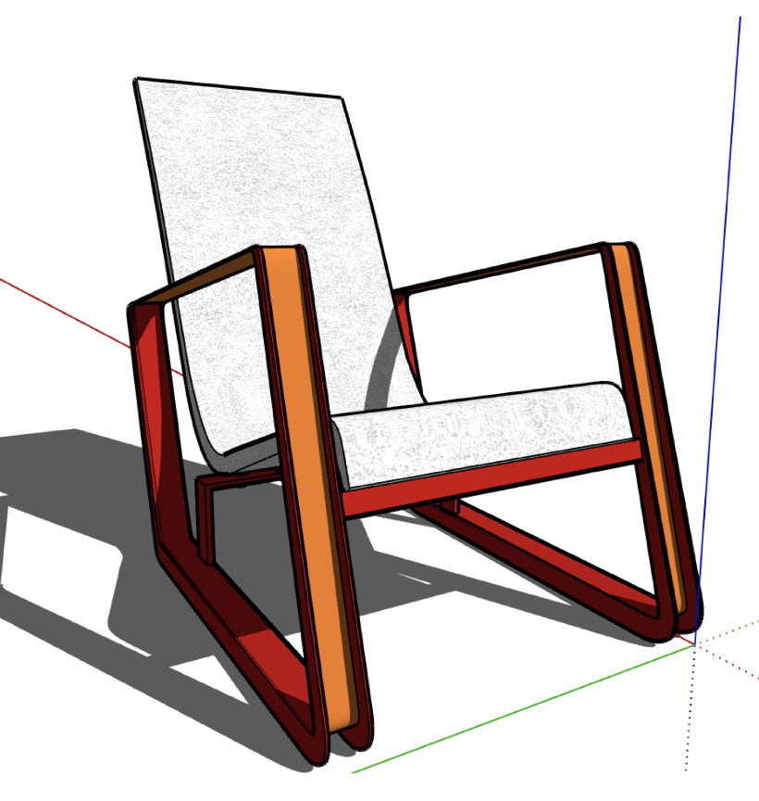
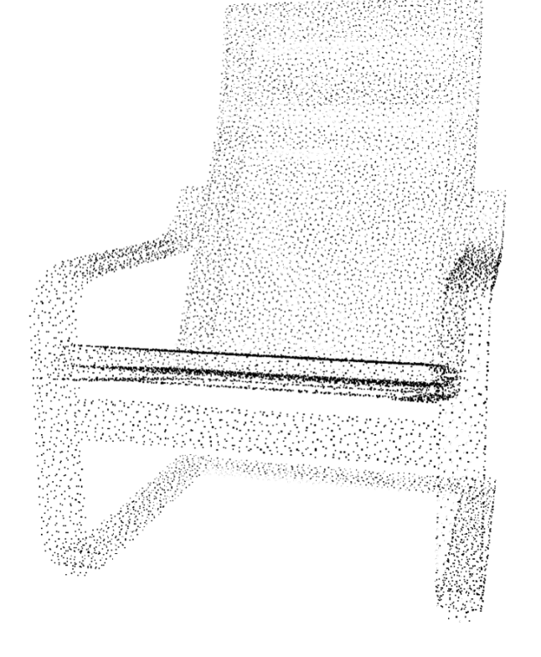
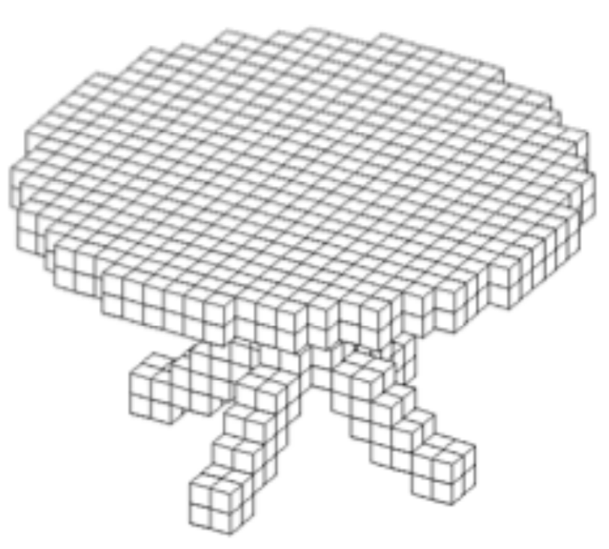
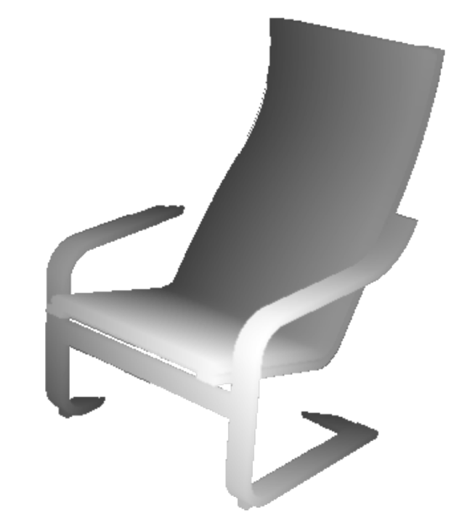
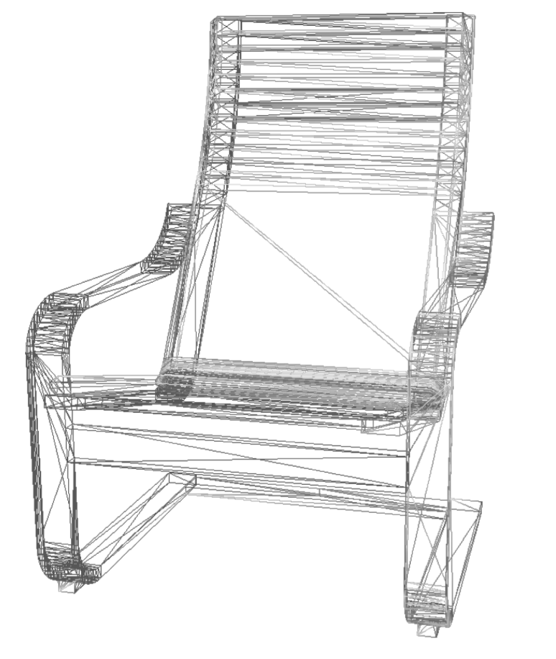
3D Representations
Depth Image
Triangle Mesh
Point Cloud
Volumetric
CAD Model
Notes:
As we all know, there are many different kinds of 3D representations such as point clouds, triangle meshes, voxels, and so on.

Slide 3
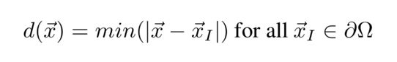
SDF --- Signed Distance Function
A distance function represents the distance between a point and the surface of the object.
A signed distance function s is a function such that s(x) = d(x) if the point x is outside the object and s(x) = -d(x) if the point x is inside the object.
Notes:
In our project, we use signed distance function as our 3D representation. A distance function represents the distance between a point and its closest point on the surface of the 3D object.
The signed distance value is positive if the point is outside the object and is negative if the point is inside the object.

Slide 4
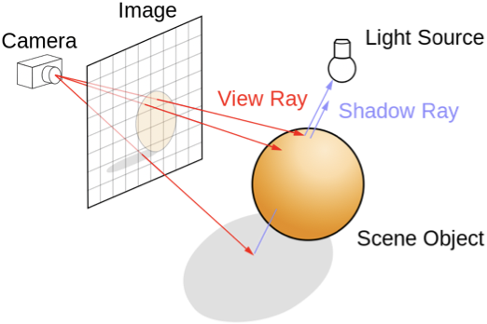
Differentiable Rendering
We make the ray tracing process be differentiable so that the pixel values of the rendered image are differentiable with respect to the SDF values of the 3D object.
Notes:
We make the ray tracing process be differentiable so that the pixel values of the rendered image are differentiable with respect to the SDF values of the 3D object.

Slide 5
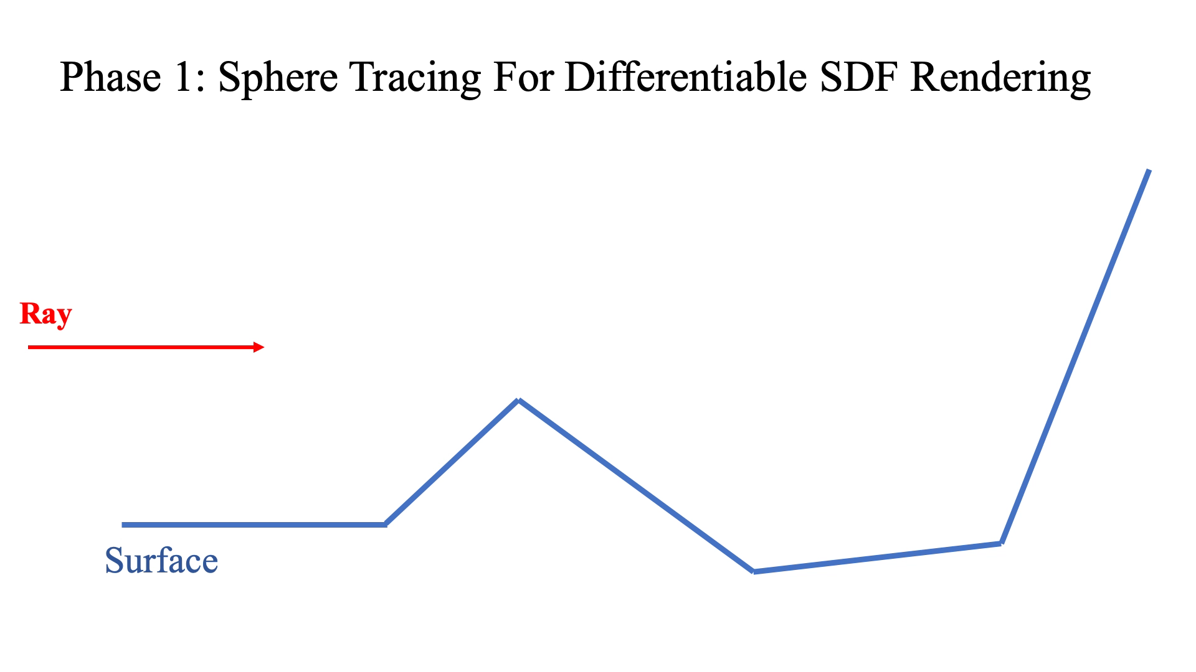

Slide 6
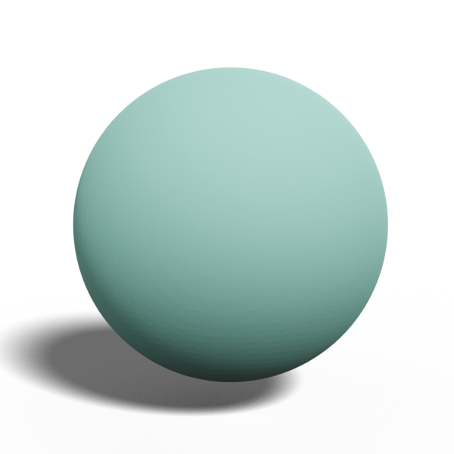
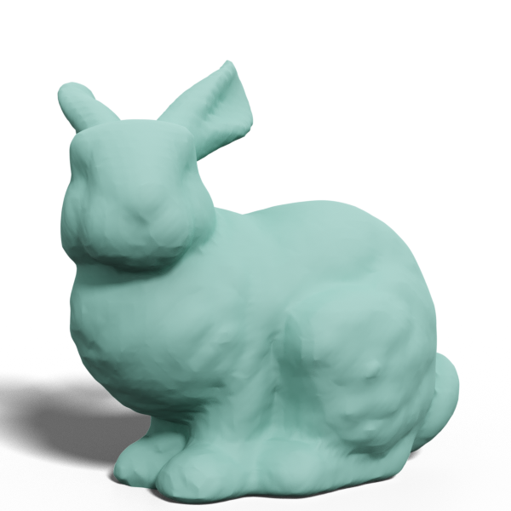
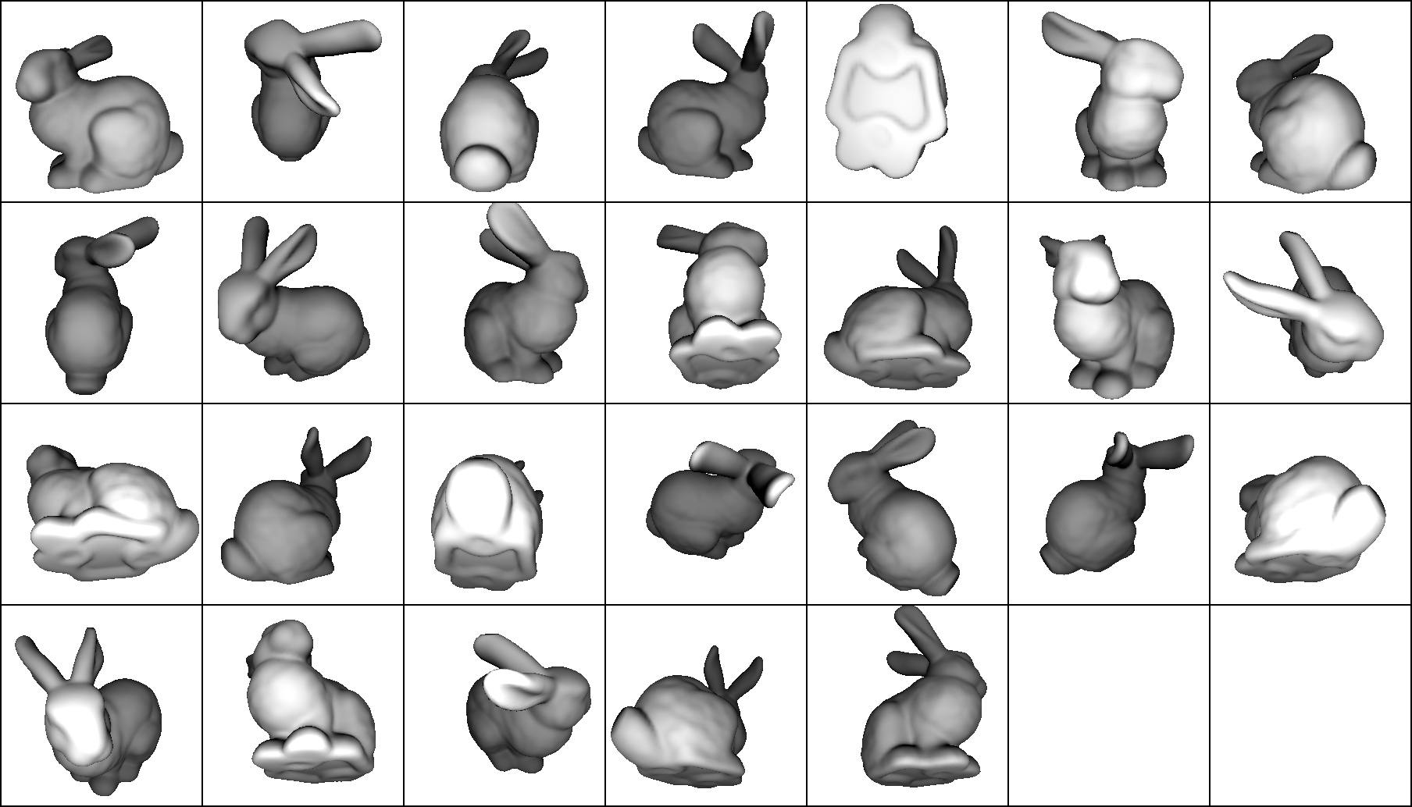
Input: Initial Object + Multi-view Images
Output: Target Object

Slide 7
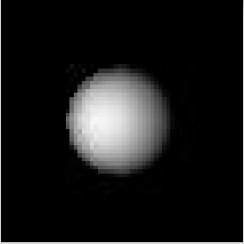
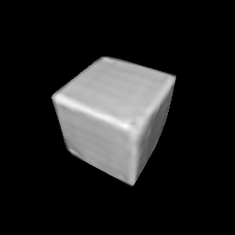
3D Reconstruction
The image can be differentiable with respect to upstream parameters, so the renderer is able to backpropagate the loss function to the signed distance function.
Our loss function consists of a pixel-wise image loss term measuring the distance between the target images and the rendered images from the 3D object and also a regularization term to make sure the output is still a valid SDF.
Multi-view images
of the target object
Initial SDF
Target SDF
Notes:
The image can be differentiable with respect to upstream parameters, so the renderer is able to backpropagate the loss function to the signed distance function. Our loss function consists of a pixel-wise image loss term measuring the distance between the target images and the rendered images from the 3D object and also a regularization term to make sure the output is still a valid SDF. So, we can achieve our target object from the initial object by backpropagation based on the multi-view images of the target object.

Slide 8
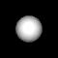
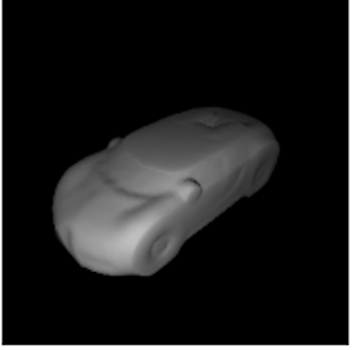
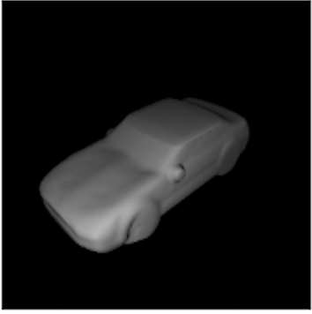
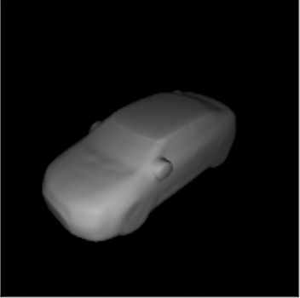
3D Reconstruction
We can achieve our target object from the initial object by backpropagation based on the multi-view images of the target object and can achieve high reconstruction quality.
Notes:
Our SDF-based Differentiable 3D reconstruction can achieve high reconstruction quality.

Slide 9
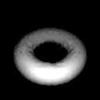
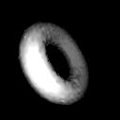
3D Reconstruction
Our SDF-based differentiable renderer can offer a higher level of freedom for topological changes compared to triangle meshes. which means that It can transform between objects with large topological differences.
Notes:
Also, previous differentiable renderers are mostly based on triangle meshes. it is difficult to change the topology of objects based on triangle meshes. Our SDF-based differentiable renderer can offer a higher level of freedom for topological changes compared to triangle meshes. which means that It can transform between objects with large topological differences.

Slide 10
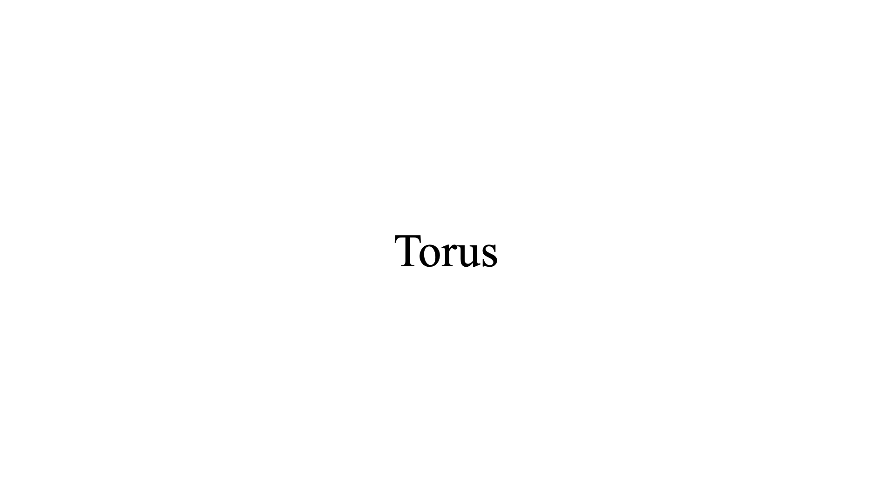

Slide 11
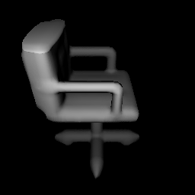
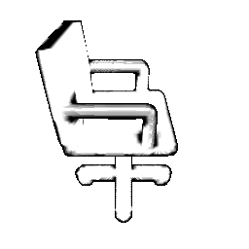
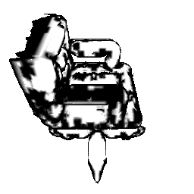
Challenges on Sketches
Our long-term goal is to enable interactive modifications on 2D sketches which can directly lead to modifications on 3D geometry.

